Slide 1
Rockbuster Stealth Analysis
John Phillips
May 2024

Slide 2
Overview
Objective: Provide a detailed analysis of our customers that can help us inform our shift into the online streaming arena.
Agenda:
Top performing countries
Most popular movies and genres
Top customers
Recommendations

Slide 3
Film Statistics: a Look into Customer Usage
Rental Duration
Min: 3 days
Max: 7 days
Avg: 5 days
Rental Rates
Min: $0.99
Max: $4.99
Avg: $2.98
Film Ratings
Most common: PG-13
Most customers rent PG-13 movies for $3 that’s just under two hours, and they keep it for about 5 days.
Film Length
Min: 46 minutes
Max: 185 minutes
Avg: 115 minutes

Slide 4
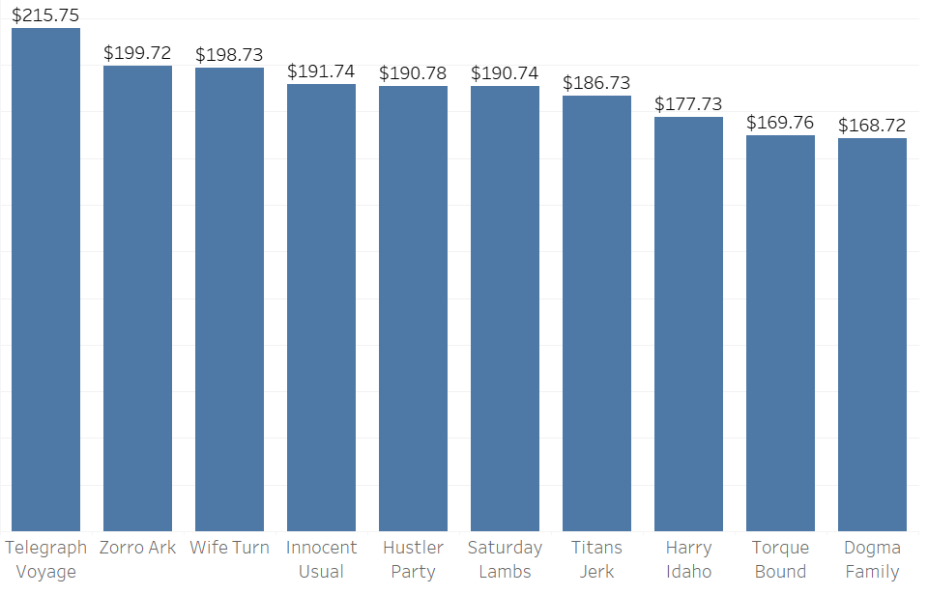
Top 10 Movies by Revenue Generated
Figuring out why these movies are so popular can help us add more like them to our database
More movies like these = more revenue

Slide 5
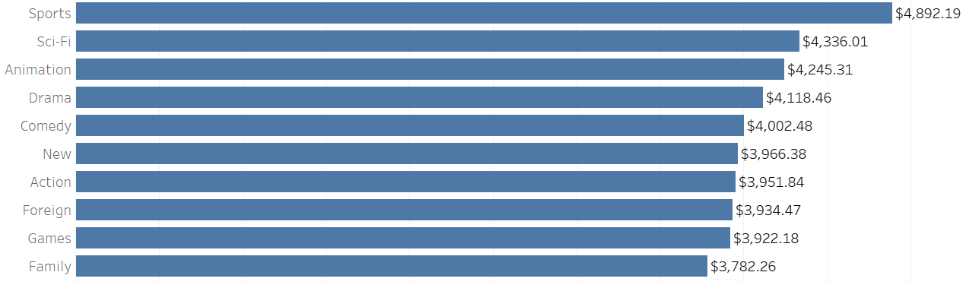
Top 10 Genres by Revenue Generated
India, China, and the US have sports and animation in their top 5- investing in these genres for those countries can lead to revenue growth.
Hosting live sporting events on our online platform can be an excellent way to boost revenue as well.

Slide 6
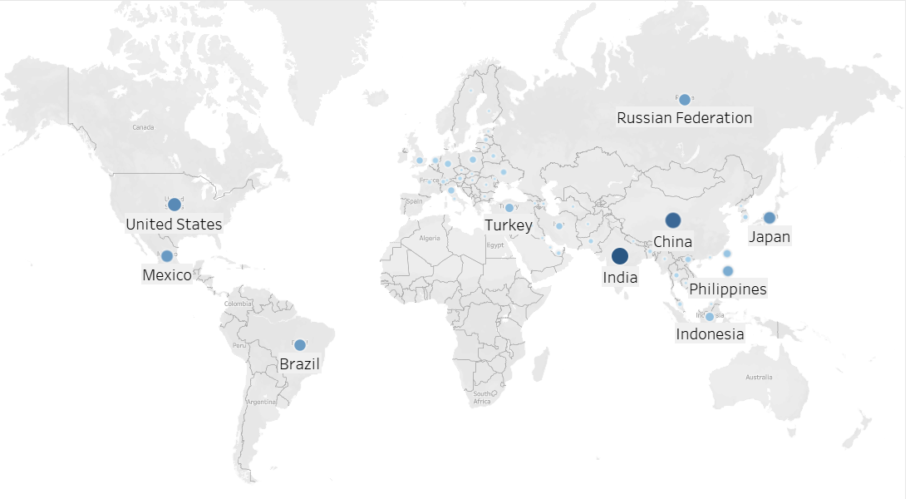
Top 10 Countries- Where’s Our Customer Base?
A lot of our customer base resides in Asia and Europe
Learning what movies these customer bases prefer can help boost our profits in those areas.

Slide 7
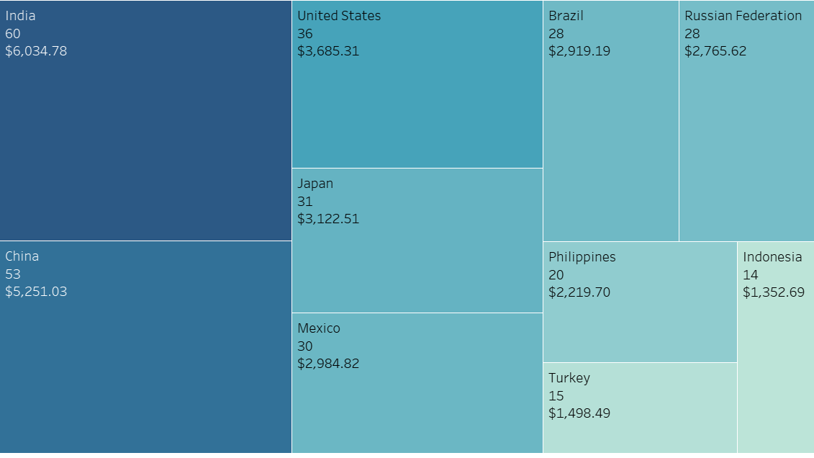
Top Countries, Customer Base and Total Revenue
The Philippines has the highest amount spent per customer
Learning about their spending habits can help us drive similar spending in other high-revenue areas.

Slide 8
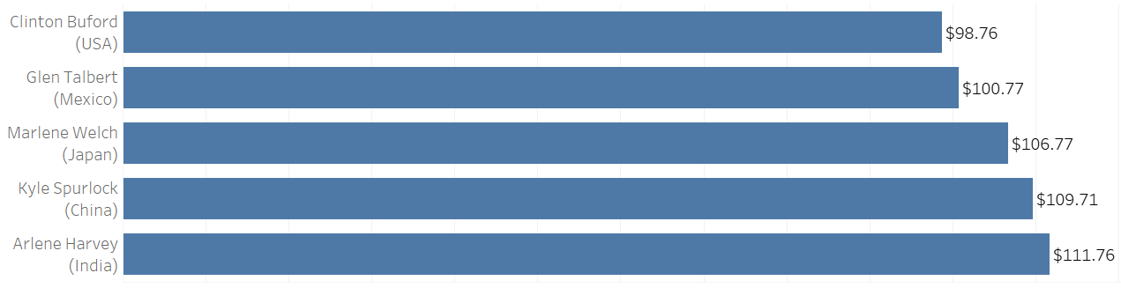
A quick spotlight: Rockbuster’s top customers
We can survey these people to learn what they like most about Rockbuster
Learning those answers can help us modify our business or database of movies to increase customer spending and engagement with the platform.

Slide 9
Concluding Summary and Recommendations
Sports, Sci-Fi, and Animation are the three best-performing genres for Rockbuster.
Investing in movies from these genres can help increase profits.
Out of the top 10 countries, 5 come from the Asian region
Between those five countries, they boast a customer base of 178 and generated revenues of $17,980.71 last year.
Continue to invest in Asia- there is a large customer base and more opportunities to increase revenue.
Despite India being the top contributing country, Rockbuster doesn’t have movies available in languages native to that country.
Consider adding movie subtitles in these languages or seeking a contract with major movie producers in India.

Slide 10
Concluding Summary and Recommendations
Invest in Asia.
As this market can drive profits for the company, it would be wise to increase spending in this area, including adding movies in languages commonly spoken in India (Hindi, Gujarati, etc.).
Add Spanish as a language- Mexico is a top 10 country and this could expand the Latin American market.
Focus on adding more movies from the sports, sci-fi, and animation genres.
Lastly, focus on movies that are around 2 hours long and are PG-13.

Slide 11
Questions?

